Slide 1

Hemodynamics
Chapter 18

Slide 2

Hemodynamics
The study of blood flow moving through the circulatory system
Components include
1) Flow – indicates the volume of blood moving during a particular time.
Measured in units liters/min (volume/time)
2) Velocity – indicates the speed of fluid moving from one location to another
Measured in units cm/sec (speed/ time)

Slide 3
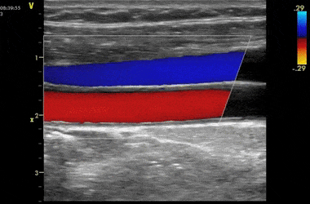
Flow
Three types of flow
1) Pulsatile – moves in a variable velocity.
Accelerates and decelerates with cardiac contraction.
Arterial circulation
2) Phasic – moves in a variable velocity.
Accelerates and decelerates with respiration.
Venous circulation
3) Steady - Moves at a constant velocity
ex. Water through a garden hose

Slide 4
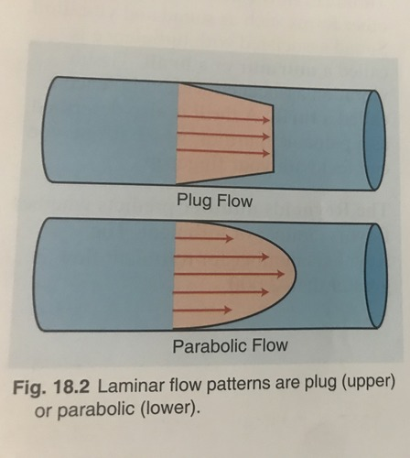
Laminar Flow
Exists when the flow streamlines are aligned and parallel
Comes from the word lamina which means layer
Found in normal physiologic flow states
Two Types
1) Plug Flow – same velocity
2) Parabolic Flow – center velocity is highest
Reynolds Number – predicts whether flow is laminar or turbulent (less than 1500 is laminar)

Slide 5
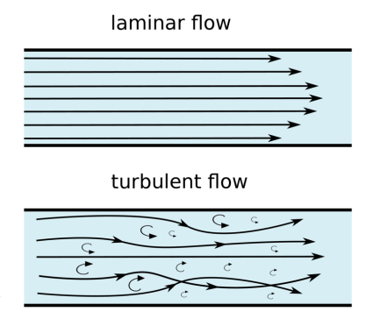
Turbulent Flow
Chaotic flow patterns that scatter in many different directions – eddy currents
Converts flow energy into other forms such as sound and vibration
Sound energy is a murmur or a bruit
Vibratory energy is a thrill
The Reynolds number for turbulent flow is greater than 2000

Slide 6

Energy
Energy Gradient – the driving force in blood flow
Three forms of energy associated with blood flow
1) Kinetic
2) Pressure
3) Gravitational

Slide 7
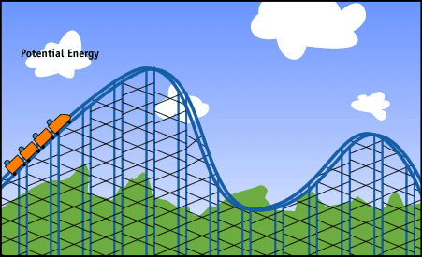
Kinetic Energy
Associated with a moving object
Determined by two factors
1) Mass
2) Speed at which it moves
Heavy objects at high speed have a large amount of kinetic energy

Slide 8
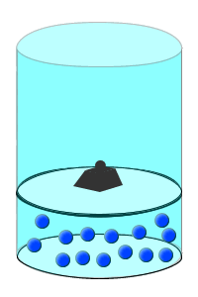
Pressure Energy
A form of stored or potential energy
Has the ability to perform work
Pressure is a major form of energy for circulating blood and creates flow by overcoming resistance.

Slide 9
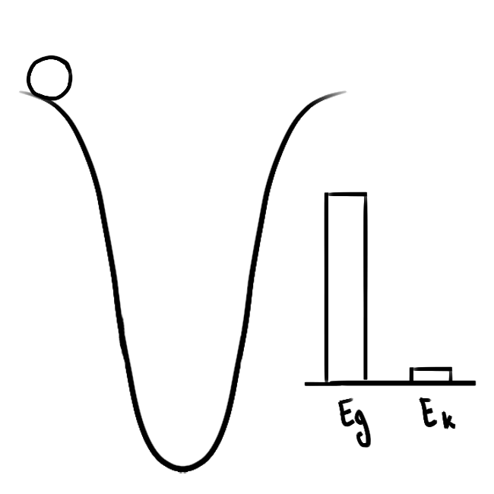
Gravitational Energy
Also a form of stored or potential energy
Gravitational energy works on elevated objects
Example: Skier at the top of a mountain vs the bottom

Slide 10
Energy Losses in Circulation
Energy is lost in circulation by:
1) Viscous Loss - Viscosity is the thickness of blood. More energy is lost with high viscosity
2) Frictional Loss – Flow energy converted to heat energy by blood sliding past vessel walls
3) Inertial Energy Loss – Relates to the tendency of fluid to resist changes in velocity

Slide 11
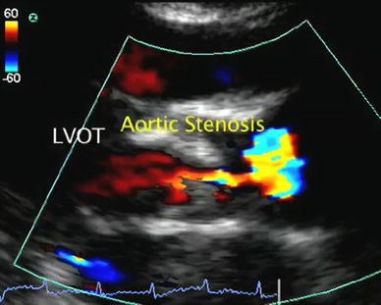
Stenosis
Refers to a narrowing in the lumen of a vessel
Has the following effects on blood flow
1) May change flow direction
2) Velocity is highest where the vessel is narrowest
3) Post stenotic turbulence
4) The pressure downstream from the stenosis is lower than the pressure upstream
5) Conversion of pulsatile flow patterns to steady flow patterns

Slide 12
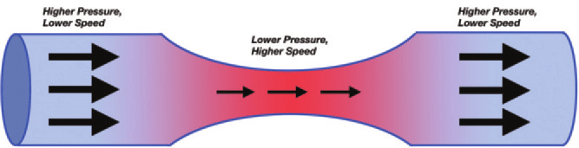
Bernoulli’s Principle
Bernoulli’s Principle describes the relationship between velocity and pressure in a moving fluid.
The sum of kinetic energy and pressure energy remains constant.
kinetic energy is associated with a moving object and increases with higher velocities.
If the velocity increases within a stenotic vessel, to remain constant, the pressure must decrease.

Slide 13
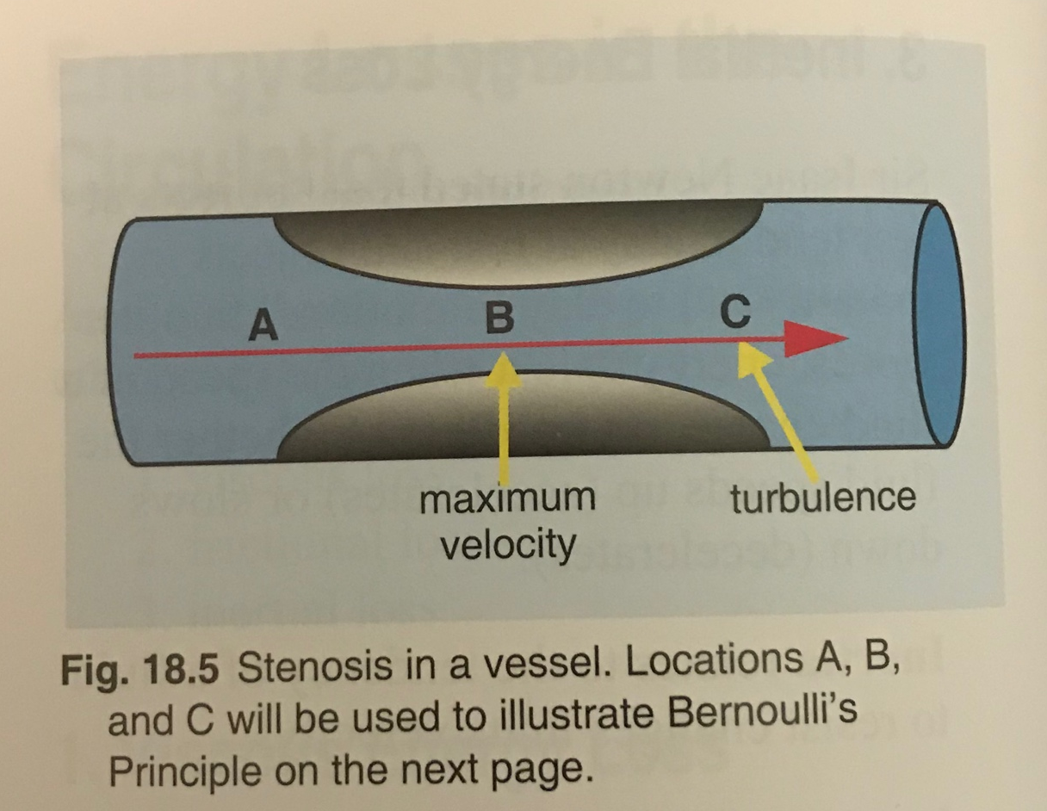
Bernoulli’s Principle
Where is the pressure lowest, at location A, B, or C?

Slide 14
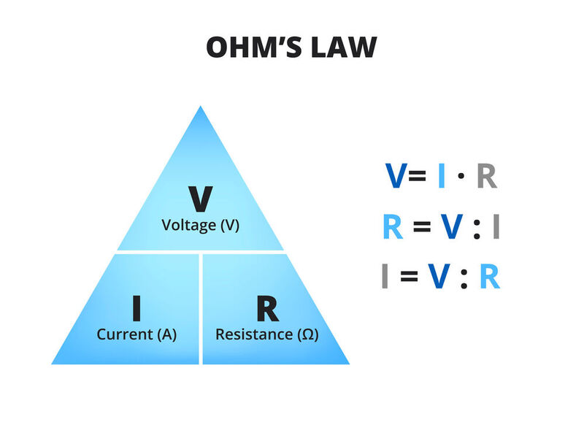
Pressure – Flow Relationship
Pressure = Flow x Resistance
Pressure Gradient increases when either
1) Flow Increases
2) Resistance Increases
Flow Increases when either
1) Pressure Gradient increases
2) Resistance decreases
These relationships are similar to Ohm’s Law

Slide 15
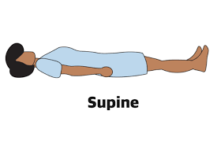
Hydrostatic Pressure
Pressure related to the weight of blood pressing on a vessel measured at a height above or below the heart
Introduces an error in the measurement of blood pressure based on the site
Supine position is a true reflection of circulatory pressure as it negates the effects of hydrostatic pressure

